Slide 1

BlinkIt Data Analysis with PowerBI
Team:
Shudhanshu Prasad
Prajakta Pawar
Pranav Rajeevan
Aman Singh
Guide:
Mimi Ma'am

Slide 2
BlinkIt Data Analysis with PowerBI
A business intelligence tool that allows users to visualize and analyze data.
Key features include data modeling, visualization, sharing, and collaboration.
Benefits include easy-to-use interface, real-time data updates, and ability to create interactive dashboards.
Team:
Shudhanshu Prasad
Prajkta Pawar
Pranav Rajeevan
Aman
Guide:
Mimi Ma'am

Slide 3
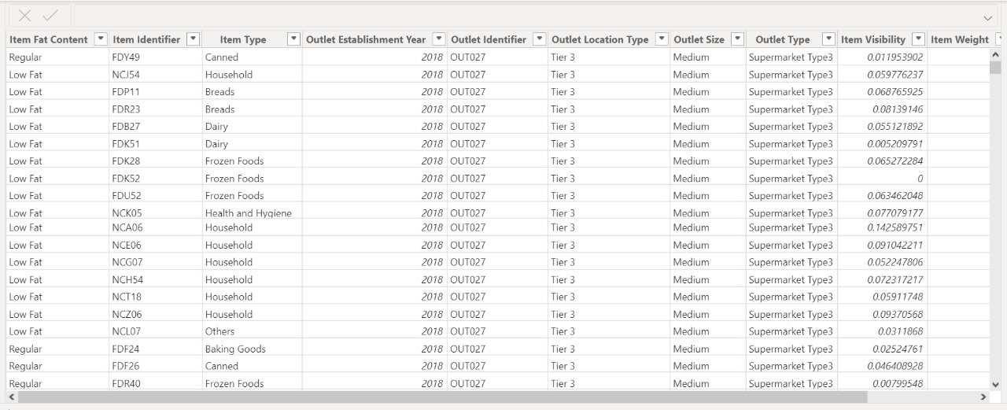
BlinkIt Data Analysis with PowerBI
Importing & Cleaning Data
What is PowerBI?
A business intelligence tool that allows users to visualize and analyze data.
Key features include data modeling, visualization, sharing, and collaboration.
Benefits include easy-to-use, real-time data updates, and ability to create interactive dashboards.
Team:
Shudhanshu Prasad
Prajkta Pawar
Pranav Rajeevan
Aman
Guide:
Mimi Ma'am

Slide 4
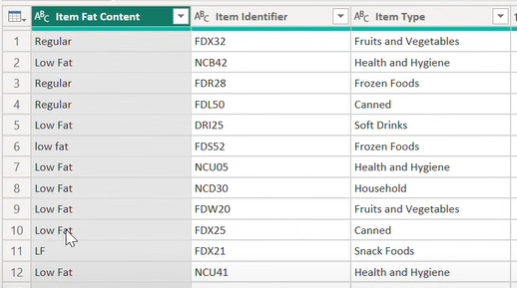
BlinkIt Data Analysis with PowerBI
Importing & Cleaning Data
What is PowerBI?
Team:
Shudhanshu Prasad
Prajkta Pawar
Pranav Rajeevan
Aman
Guide:
Mimi Ma'am
A business intelligence tool that allows users to visualize and analyze data.
Key features include data modeling, visualization, sharing, and collaboration.
Benefits include easy-to-use, real-time data updates, and ability to create interactive dashboards.

Slide 5
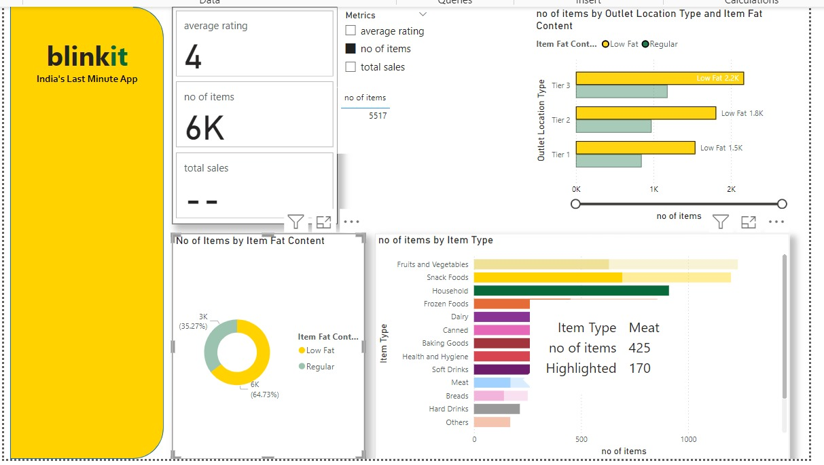
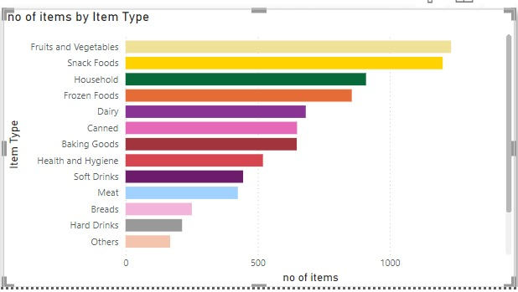
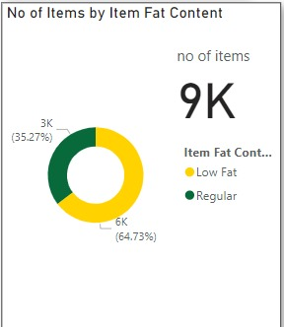
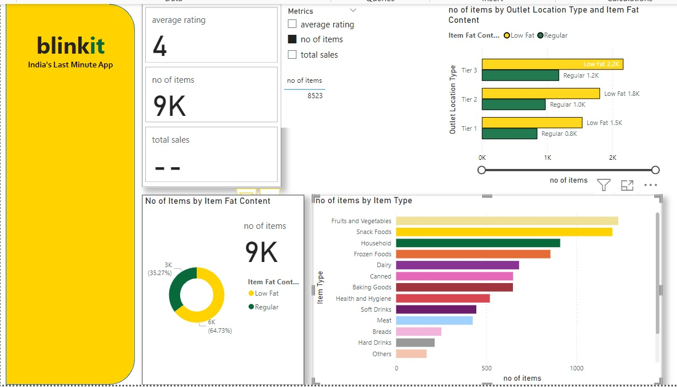
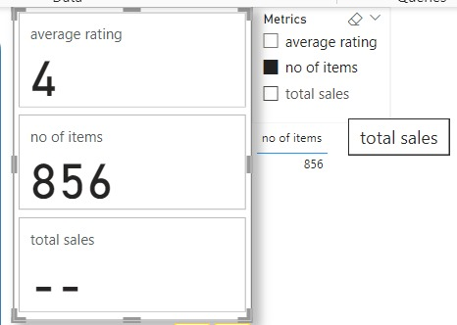
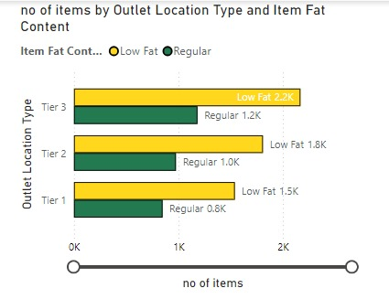
BlinkIt Data Analysis with PowerBI
Creating Visualizations
Importing & Cleaning Data
Team:
Shudhanshu Prasad
Prajkta Pawar
Pranav Rajeevan
Aman
Guide:
Mimi Ma'am

Slide 6
BlinkIt Data Analysis with PowerBI
Creating Visualizations
Importing & Cleaning Data
Team:
Shudhanshu Prasad
Prajkta Pawar
Pranav Rajeevan
Aman
Guide:
Mimi Ma'am

Slide 7
BlinkIt Data Analysis with PowerBI
Creating Visualizations
Importing & Cleaning Data
Team:
Shudhanshu Prasad
Prajkta Pawar
Pranav Rajeevan
Aman
Guide:
Mimi Ma'am

Slide 8
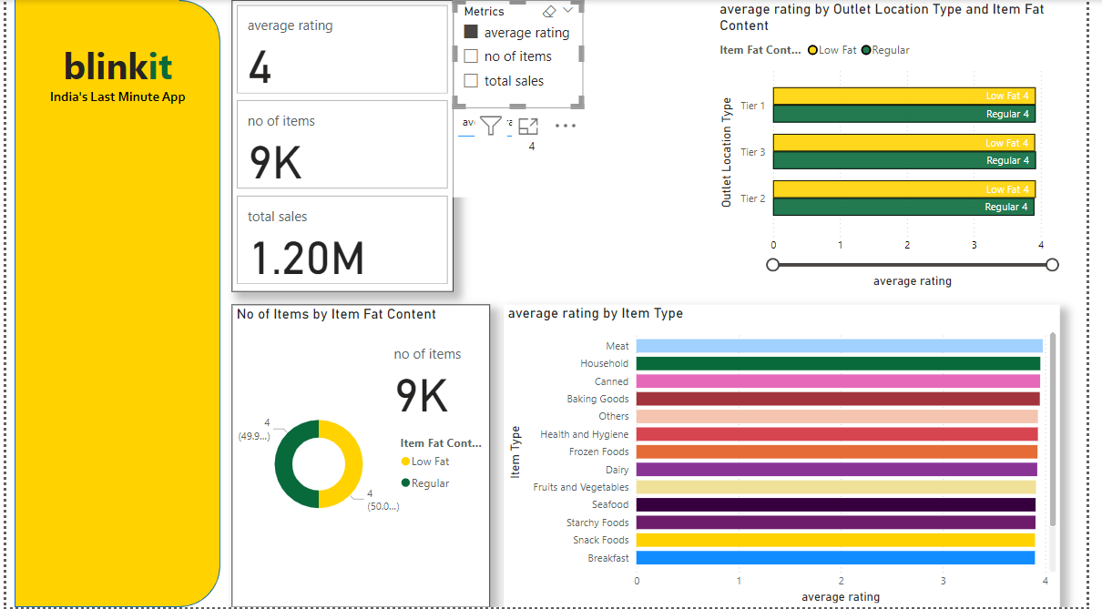
BlinkIt Data Analysis with PowerBI
Creating Visualizations
Importing & Cleaning Data
Team:
Shudhanshu Prasad
Prajkta Pawar
Pranav Rajeevan
Aman
Guide:
Mimi Ma'am

Slide 9
BlinkIt Data Analysis with PowerBI
Creating Visualizations
Importing & Cleaning Data
Team:
Shudhanshu Prasad
Prajkta Pawar
Pranav Rajeevan
Aman
Guide:
Mimi Ma'am

Slide 10
BlinkIt Data Analysis with PowerBI
Creating Visualizations
Importing & Cleaning Data
Team:
Shudhanshu Prasad
Prajkta Pawar
Pranav Rajeevan
Aman
Guide:
Mimi Ma'am

Slide 11
BlinkIt Data Analysis with PowerBI
Thank You
Importing & Cleaning Data
Team:
Shudhanshu Prasad
Prajkta Pawar
Pranav Rajeevan
Aman
Guide:
Mimi Ma'am

Slide 12
BlinkIt Data Analysis with PowerBI
Thank You
Team:
Shudhanshu Prasad
Prajakta Pawar
Pranav Rajeevan
Aman Singh
Guide:
Mimi Ma'am
Importing & Cleaning Data

